Slide 2
Chapter Goals
Output Variables
Add Azure Subnets and Network Interfaces!
Quiz
Modules
Quiz
Bonus!

Slide 3
Output Variables

Slide 4
Glossary
Output
An output is a configurable piece of information that is highlighted at the end of a Terraform run.

Slide 5
Outputs
Outputs define values that will be highlighted to the user when Terraform applies.
Outputs can be queried using the terraform output command.
Outputs are a way to easily extract and query information from all of Terraform's collected data.
Notes:
Outputs allow customization of Terraform's output during a Terraform apply.
This also allows for specific outputs to be queried with the Terraform Output command. This can help drive external automation by populating output values for other tools or configuration files.

Slide 6
outputs.tf
output "vn_address_space" {
value = "${azurerm_virtual_network.myfirstvn.address_space}"
}
Notes:
Here is what an output definition looks like.
Although not required, it's usually recommended to define outputs at the end of the file for easy searching. Type this output in your file now.

Slide 7
Run terraform refresh
Run terraform refresh to pick up the new output values.

Slide 8
PS> terraform refresh
Refreshing state...
Outputs:
vn_address_space = [
10.0.0.0/16
]
Notes:
Here's a sample solution.

Slide 9
PS> terraform apply
Apply complete! Resources: 1 added, 0 changed, 1 destroyed.
Outputs:
vn_address_space = [
10.0.0.0/16
]
Notes:
Here's a sample solution.

Slide 10
PS> terraform plan
Output: ?????????
Notes:
Here's a sample solution.

Slide 11
Query Output
Use the terraform output command to query for all outputs.
Use the terraform output command to query for a single output.

Slide 12
PS> terraform output
vn_address_space = [
10.0.0.0/16
]

Slide 13
PS> terraform output vn_address_space 10.0.0.0/16
Notes:
You can also query for a specific output.

Slide 14
Group Lab
Add an Azure Subnet to our code base to segment the virtual network
Add Variables to parameterize our code base
Output the Address Prefix in the subnet for later use

Slide 15

Azure Subnet
Subnet (Default is One Subnet)
Segments the virtual network into one or more subnets and allocates a portion of the virtual network’s address space to each subnet

Slide 16
main.tf
resource "azurerm_virtual_network" "myfirstvn" { ``` }
resource "azurerm_subnet" "myfirstsubnet" {
name = "${var.sb_name}"
resource_group_name = "${azurerm_resource_group.myfirstrg.name}"
virtual_network_name = "${azurerm_virtual_network.myfirstvn.name}"
address_prefix = "${var.sb_address_prefix}"
}
Notes:
We are calling out the variables here…

Slide 17
variables.tf
variable "vn_location" {
type = "string"
default = "East US"
description = "This variable defines the virtual network location"
}
variable "sb_name" {
type = "string"
default = "myfirstsubnet"
description = "This variable defines the subnet name."
}
variable "sb_address_prefix" {
type = "string"
default = "10.0.2.0/24"
description = "This variable defines the subnet address prefix."
}
Notes:
Now we define those variables

Slide 18
outputs.tf
output "vn_address_space" {
value = "${azurerm_virtual_network.myfirstvn.address_space}"
}
output "sb_address_prefix" {
value = "${azuremr_subnet.myfirstsubnet.address_prefix}"
}
Notes:
And finally add an output

Slide 19
(Resource) Attribute
Just because a resource does not explicitly define output does not mean that it cannot be accessed or consumed its just not displayed

Slide 20
Glossary
(Resource) Attribute
An attribute is an output or computed value available only after resource creation.

Slide 21
main.tf
resource "azurerm_virtual_network" "myfirstvn" {
name = "${var.vn_name}"
address_space = "${var.vn_address_space}"
location = "${var.vn_location}"
resource_group_name = "${var.resource_group_name}"
}
resource "azurerm_subnet" "myfirstsubnet" {
name = "${var.sb_name}"
resource_group_name = "${azurerm_resource_group.myfirstrg.name}"
virtual_network_name = "${azurerm_virtual_network.myfirstvn.name}"
address_prefix = "${var.sb_address_prefix}"
}
Note how you can refer to other resources using their identifier.

Slide 22
PS> terraform plan
An execution plan has been generated and is shown below. Resource actions are indicated with the following symbols:
+ create
Terraform will perform the following actions:
+ azurerm_subnet.myfirstsubnet
id: <computed>
address_prefix: "10.0.2.0/24"
ip_configurations.#: <computed>
name: "myfirstsubnet"
resource_group_name: "myfirstresourcegroup"
virtual_network_name: "myfirstvn"
Plan: 1 to add, 0 to change, 0 to destroy.
------------------------------------------------------------------------
Notes:
Here is some sample output.

Slide 23
PS> terraform apply
azurerm_subnet.myfirstsubnet: Creating...
address_prefix: "" => "10.0.2.0/24"
ip_configurations.#: "" => "<computed>"
name: "" => "myfirstsubnet"
resource_group_name: "" => "myfirstresourcegroup" virtual_network_name: "" => "myfirstvn”
Apply complete! Resources: 1 added, 0 changed, 0 destroyed.
Outputs:
vn_address_space = [
10.0.0.0/16
]
Notes:
Here is some sample output.

Slide 24
PS> terraform output
sb_address_prefix = 10.0.2.0/24

Slide 25
PS> terraform output sb_address_prefix
10.0.2.0/24
Notes:
You can also query for a specific output.

Slide 26
Chapter Goals
Output Variables
Add Azure Subnets and Network Interfaces!
Quiz
Modules
Quiz
Bonus!

Slide 27
Quiz
What values can be accessed in a Resource for Output?
What is the interpolation format for accessing an attribute?
What is an Azure Subnet used for?
Notes:
Attributes

Slide 28
Modules

Slide 29
Modules
Portable Terraform configurations (packages)
Allow separation of concerns and responsibilities among teams
Parallels: Chef Cookbook, Puppet Module, Ruby gem

Slide 30
Modules
Spoiler Alert!
Modules are just Terraform configurations inside a folder - there's nothing special about them.

Slide 31
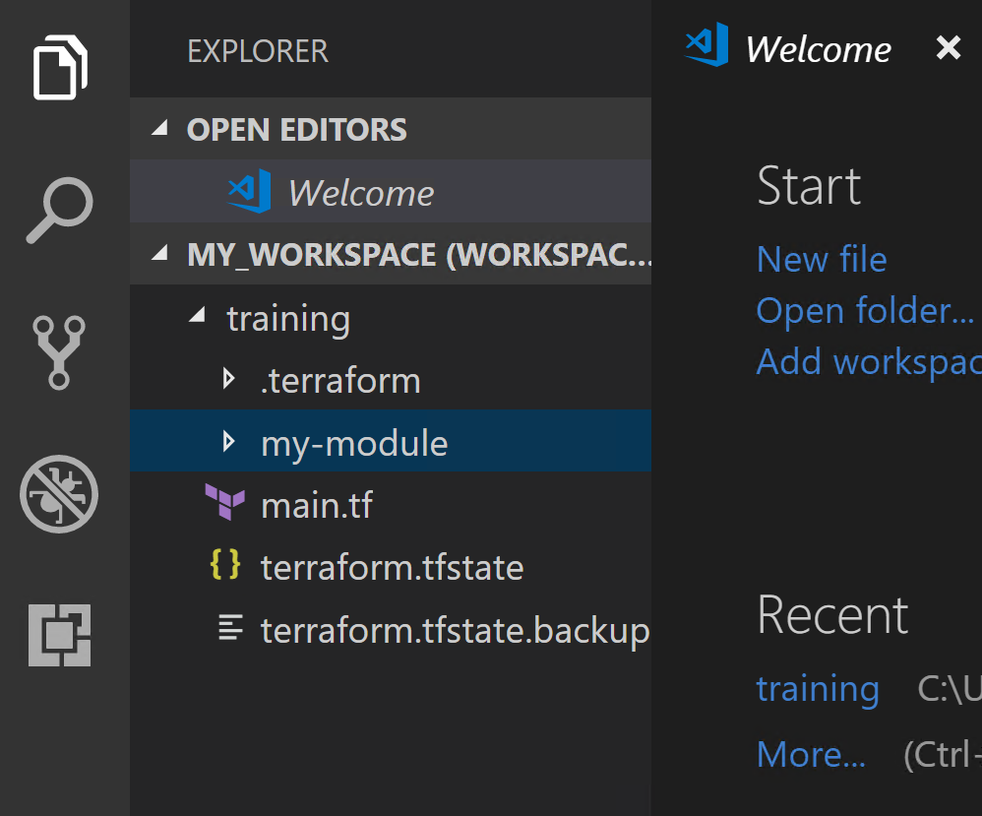
Create a directory called my-module
Notes:
This goes inside your 'training' folder.
NOTE: I vote to remove these slides. Modules are complex, you should learn to use them first before you learn to create them.

Slide 32
my-module/main.tf
resource "azurerm_network_security_group" "myfirstnsg" { name = "myfirstnsg" location = "eastus" resource_group_name = "myfirstrg" security_rule { name = "SSH" priority = 1001 direction = "Inbound" access = "Allow" protocol = "Tcp" source_port_range = "*" destination_port_range = "${var.destination_port}" source_address_prefix = "*" destination_address_prefix = "*" } }
Notes:
Here is what that main.tf file may look like. We are defining two variables, one resource, and one output.

Slide 33
my-module/variables.tf
variable "destination_port" { type = "string" default = "22" description = "This variable defines the inbound port." }
Notes:
Notice now we are in a different Terraform file.
When we want to consume this module, we first declare the source of the module. The source can be any URL or file path.

Slide 34
outputs.tf
output "myfirstnsg" { value = "${azurerm_network_security_group.myfirstnsg.name}" }
Notes:
Next, any variables that were declared inside of the module become arguments (inputs) to the module stanza.

Slide 35
Modules
Variables defined in module => Arguments to module stanza
Outputs defined in module => Attributes from module definition
Configuration is blackbox
Individual resource arguments are not accessible outside the module
Notes:
Add some whiteboarding here to really drive home exactly what a module is. It's a black box with configurable inputs and outputs.

Slide 36
main.tf
module "my-module" { source = "./my-module" # Source can be any URL or file path argument_1 = "value" argument_2 = "value" }
output "example" { value = "${module.my-module.azure_virtual_machine.id}" }
Notes:
It is not possible to access the resources inside of the module individually. If you need access to a resources' attributes, you must output them.

Slide 37
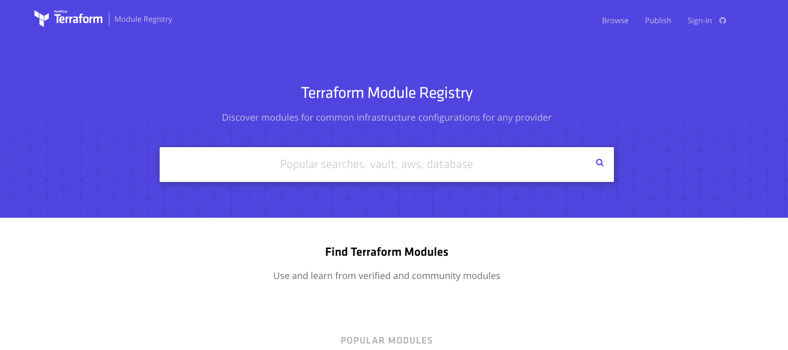
Community Modules
Notes:
There is a GitHub organization for community modules which you can use as best practice guidelines. These should be forked, not blindly copied.

Slide 38
Exercise: Use Module
There is a module named “compute" in the Terraform Registry to use with azure
Use this module in main.tf with the name "example".
Notes:
This is a very basic module that has just one resource. Import it into your main.tf.

